Slide 1








First Person
game engine

Slide 2
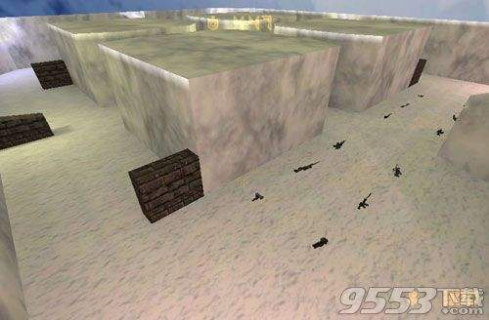
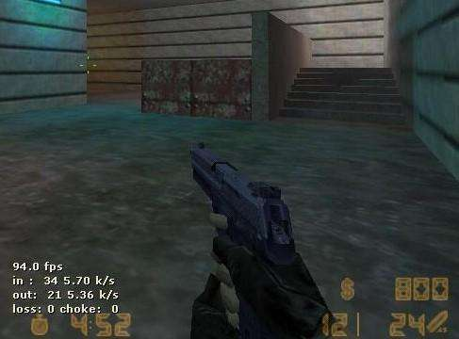
By photo learn about Engine

Slide 3
pain points
goal
interaction
submodules
Technical challenge

Slide 4
pain points
Xiao Ming is infatuated with First Person Game.Although the design desire is very strong , the coding ability is very poor. He really want a tool help him design a FP game according his own prefence.

Slide 5
goal
According to own prefence to design the FPG.
As much as possible to provide the user with the functions
Easy to use

Slide 6
interaction
Set game parameters: background, ,weapon, weather, speed, light,color, size, map, speed,etc.

Slide 7
submodules
Engine
map
player
wall
rain
light
collision

Slide 8
Technical challenge
Ray casting does not render the entire scene at a time. Instead, it divides the scene into separate columns and then renders them one by one. Each column represents a ray of light projected from a particular point of view. If the light hits the wall, the engine will calculate the distance to the wall and draw a rectangle in the column. The height of a rectangle depends on the length of the light .

Slide 9
We first find out the angle of each ray. The angle depends on three points: the player's orientation, the camera's view, and the column being drawn
Next, we have to check every light passing through the wall. The goal here is to eventually come up with an array that lists each side of the wall after the light leaves the player . Starting from the player, we find the closest lateral (stepX) and longitudinal (stepY) grid coordinates. Move to the nearest place and check if there is a wall (inspect). Repeat until all lines of track are tracked. Looking for grid points is simple: only need to x rounded down (1,2,3...) And then multiplied by the slope of the light (rise/run) to obtain y . We don't have to care about the size of the map! Just focus on specific points on the grid
After tracing a ray of light, we have to draw all the walls on the path

Slide 10
thank you

